Slide 1
Different Levels of Maturity Model
Lecture 6

Slide 2
5 Levels of TMM (Test Maturity Model)
The five levels of the TMM helps the organization to determine the maturity of its process and to identify the next improvement steps that are essential to achieving a higher level of test maturity.

Slide 3
Level 1
TMM Levels | Goals | An objective of TMM levels
Level 1: Initial | Software should run successfully | At this level, no process areas are identified An objective of testing is to ensure that software is working fine This level lacks resources, tools, and trained staff No Quality Assurance checks before software delivery

Slide 4
Level 2
Level 2: Defined | Develop testing and debugging goals and policies | This level distinguish testing from debugging & they are considered distinct activities Testing phase comes after coding A primary goal of testing is to show software meets specification Basic testing methods and techniques are in place

Slide 5
Level 3
Level 3: Integrated | Integration of testing into the software lifecycle | Testing gets integrated into an entire life cycle Based on requirements test objectives are defined Test organization exists Testing recognized as a professional activity

Slide 6
Level 4
Level 4: Management and Measurement | Establish a test measurement program | Testing is a measured and quantified process Review at all development phases are recognized as tests For reuse and Regression Testing, test cases are gathered and recorded in a test database Defects are logged and given severity levels

Slide 7
Level 5
Level 5: Optimized | Test process optimization | Testing is managed and defined Testing effectiveness and costs can be monitored Testing can be fine-tuned and continuously improved Quality control and Defect prevention are practiced Process reuse is practiced Test related metrics also have tool support Tools provide support for Test Case design and defect collection

Slide 8
ISO 9000 Quality Management Principles

Slide 9
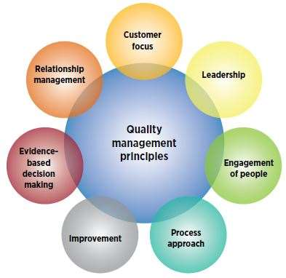
ISO 9000:2015 principles of Quality Management
The ISO 9000:2015 and ISO 9001:2015 standards are based on seven quality management principles
that senior management can apply
to promote organizational improvement.

Slide 10
Customer focus
Understand the needs of existing and future customers
Align organizational objectives with customer needs and expectations
Meet customer requirements
Measure customer satisfaction
Manage customer relationships
Aim to exceed customer expectations
Learn more about the customer experience and customer satisfaction

Slide 11
Leadership
Establish a vision and direction for the organization
Set challenging goals
Model organizational values
Establish trust
Equip and empower employees
Recognize employee contributions
Learn more about leadership

Slide 12
Engagement of people
Ensure that people’s abilities are used and valued
Make people accountable
Enable participation in continual improvement
Evaluate individual performance
Enable learning and knowledge sharing
Enable open discussion of problems and constraints
Learn more about employee involvement

Slide 13
Process approach
Manage activities as processes
Measure the capability of activities
Identify linkages between activities
Prioritize improvement opportunities
Deploy resources effectively
Learn more about a process view of work and see process analysis tools

Slide 14
Improvement
Improve organizational performance and capabilities
Align improvement activities
Empower people to make improvements
Measure improvement consistently
Celebrate improvements
Learn more about approaches to continual improvement

Slide 15
Evidence-based decision making
Ensure the accessibility of accurate and reliable data
Use appropriate methods to analyze data
Make decisions based on analysis
Balance data analysis with practical experience
See tools for decision making

Slide 16
Relationship management
Identify and select suppliers to manage costs, optimize resources, and create value
Establish relationships considering both the short and long term
Share expertise, resources, information, and plans with partners
Collaborate on improvement and development activities
Recognize supplier successes
Learn more about supplier quality and see resources related to managing the supply chain

